Slide 1

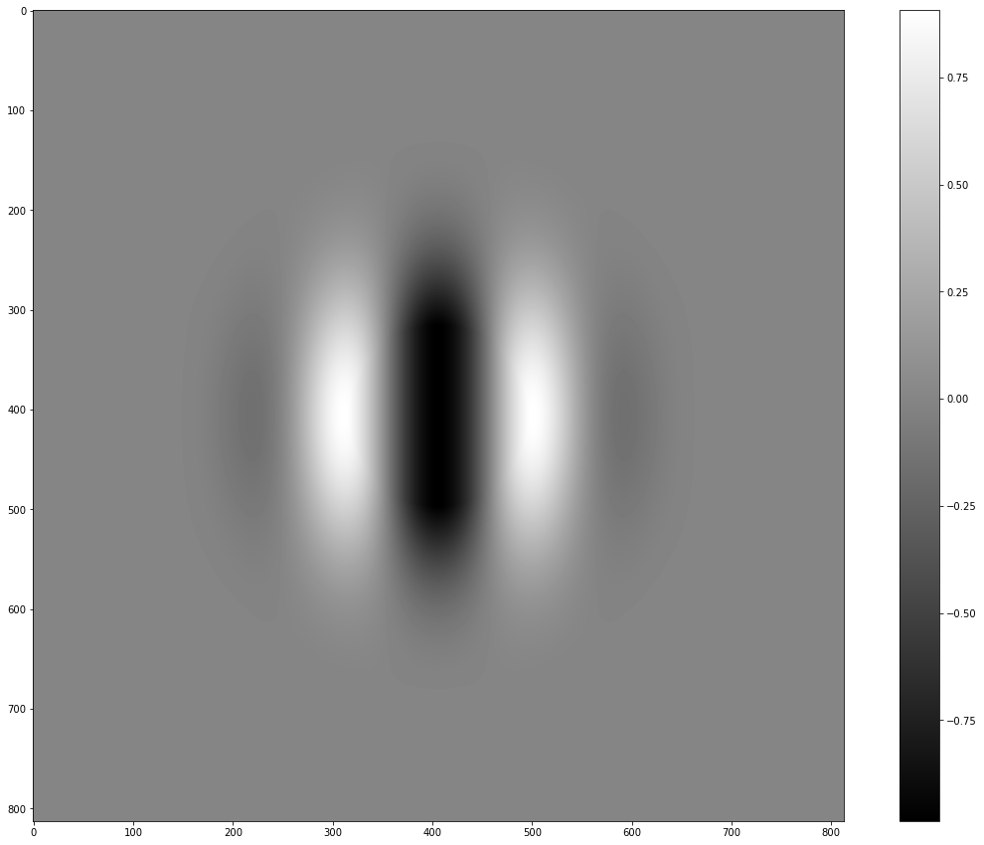
Alpha vs conv | Gauss mean = 0.1

Slide 2


Gauss mean = 0 vs 0.05 vs 0.1

